Slide 1


An Efficient Sliding Window Approach for Approximate Entity Extraction with Synonyms
Jin Wang (UCLA)
Chunbin Lin (Amazon AWS)
Mingda Li (UCLA)
Carlo Zaniolo (UCLA)

Slide 2
Outline
Motivation
Preliminaries
Framework and Techniques
Experiments
Conclusion

Slide 3
Dictionary-based Entity Extraction
Dictionary of Entities
Isaac Newton
Sigmund Freud
English Austrian
physicist
Mathematician
astronomer
philosopher
alchemist theologian
psychiatrist
economist historian
sociologist ...
Documents
1 Sir IsaacNewton was an English physicist, mathematician, astronomer, natural philosopher, alchemist, and theologian and one of the most influential men in human history. His Philosophiæ Naturalis Principia Mathematica, published in 1687, is by itself considered to be among the most influential books in the history of science, laying the groundwork for most of classical mechanics.
2 Sigmund Freund was an Austrian psychiatrest who founded the psychoanalytic school of psychology. Freud is best known for his theories of the unconscious mind and the defense mechanism of repression and for creating the clinical practice of psychoanalysis for curing psychopathology through dialogue between a patient and a psychoanalayst.

Slide 4
Approximate Entity Extraction (AEE)
Example Application: product search
Document
The Canon G7 X offers a superb image processing……
Dictionary
Canon PowerShot G7 X digital camera
Acer Swift 3 laptop
……
… PowerShot G7 X captures stunning
HD video…..

Slide 5
Limitations of AEE
Strings with low syntactic similarity can still be similar!
Dictionary
e1
e2
e3
e4
cerebral malaria
consumption coagulopathy
adult respiratory distress syndrome
acute kidney insufficiency
Document
...... When first observed the patient was in shock and had signs of cerebral malaria, disseminated intravascular coagulation, and acute respiratory distress syndrome, which in the following 2 days were complicated by acute renal failure ......
1
2
3
4

Slide 6
Synonym Rules
Goal
Improve the quality of AEE
Combine the semantics carried by synonyms with the syntactic similarity
Examples
Abbreviation
University of California, Los Angeles UCLA
Same identity
disseminated intravascular coagulation consumption coagulopathy

Slide 7
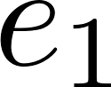
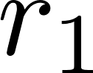
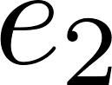
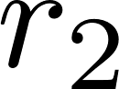
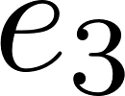
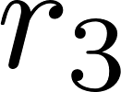
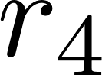
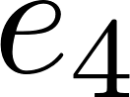
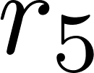
Approximate Entity Extraction with Synonyms
Example: Institute Name in DB World
Dictionary
Synonym rules
Google USA
University of Chicago USA
UQ AU
UW USA
AU ⬄ Australia
Univ. ⬄ University
UQ ⬄ University of Queensland
UW ⬄ University of Washington
UW ⬄ University of Waterloo
Document (VLDB 2018 Research Track PC members)
Dan Ports (Univ. of Washington USA), Haryadi Gunawi (Univ. of Chicago USA), Sandeep Tata (Google USA), Xiaofang Zhou (University of Queensland Australia)
……

Slide 8
Outline
Motivation
Preliminaries
Framework and Techniques
Experiments
Conclusion

Slide 9
Set-based Similarity
Common similarity functions:
Jaccard:
Cosine:
Dice:
x = {A,B,C,D,E} y = {B,C,D,E,F}
4/6 = 0.67
4/5 = 0.8
8/10 = 0.8

Slide 10
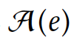
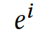
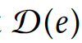
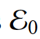
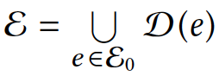
Basic Terminology
UW USA
Entity
Applicable rule
Applicable rule set
Derived Entity
The combination of rule applications
In above example:
Given an entity e, its set of derived entities
Derived Dictionary
Given the original dictionary
1. UW<-> University of Washington
2. UW <-> University of Waterloo
3. USA <-> United States of America
{ {1,3}, {2,3} }
UW United States of America

Slide 11
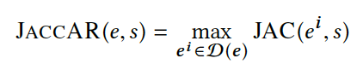
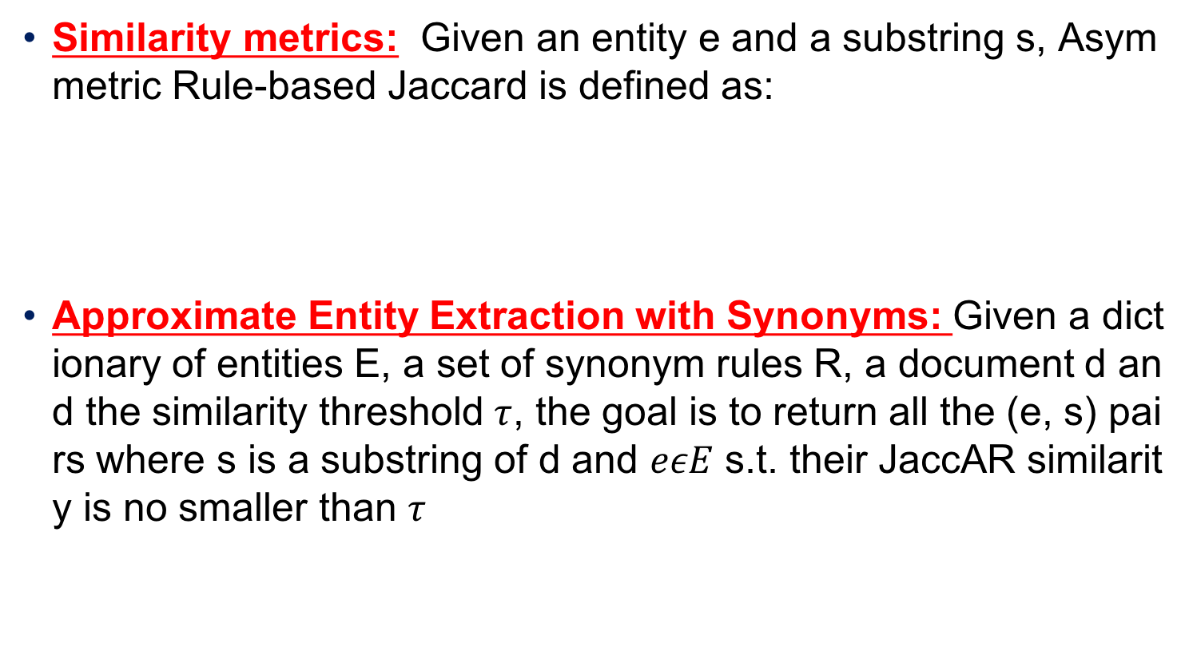
Problem Formulation
Similarity metrics: Given an entity e and a substring s, Asymmetric Rule-based Jaccard is defined as:
Approximate Entity Extraction with Synonyms: Given a dictionary of entities E, a set of synonym rules R, a document d and the similarity threshold $τ$, the goal is to return all the (e, s) pairs where s is a substring of d and $eεE$ s.t. their JaccAR similarity is no smaller than $τ$

Slide 12
Outline
Motivation
Preliminaries
Framework and Techniques
Experiments
Conclusion

Slide 13

Overall Framework
Offline index building
Online approximate entity extraction
Filter
Document
Dictionary
Index Builder
Inverted Indexes
candidates
Synonyms
Verifier
results

Slide 14
Prefix Filter [Chaudhuri et al. 2006]
Sort the tokens by a global ordering
E.g. increasing order of document frequency
Only need to index the first few tokens (prefix) for each record
Example:
jaccard t = 0.8 → |x ∩ y| ≥ 4 if |x|=|y|=5
x =
y =
Must share at least one token in prefix to be a candidate pair
For jaccard, prefix length = |x| * (1 – t) + 1 → each t is associated with a prefix length
sorted
C | D
E | F | G
upper bound_{O(x,y)} = 3 < 4!
X
E | F | G
A | B
prefix
sorted

Slide 15
Index Structure
Support prefix filter and length filter
If the length difference between two strings are beyond a range, they cannot be similar
Group by length and original entity

Slide 16
Index Structure: Example

Slide 17
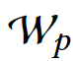
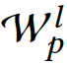
Candidate Generation
Terminology
Naïve Approach
Enumerate Substrings and apply prefix filter
Bound the window size with length filter
Improving pruning power
Dynamic Prefix Computation
Window Extend
Window Migrate
Lazy Candidate Generation
Core idea: Scan the inverted list for each token only once
Window
4
8
10
3
6
18
2
20
3
6
Substring

Slide 18
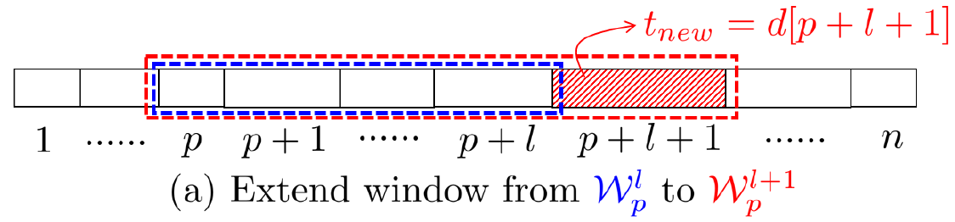
Dynamic Prefix Computation
Window Extend
2
4
8
10
3
6
18
2
20
3
6
10
4
8
10
3
6
18
2
20
3
6
1
2
3
4
5
6
7
8
9
10

Slide 19
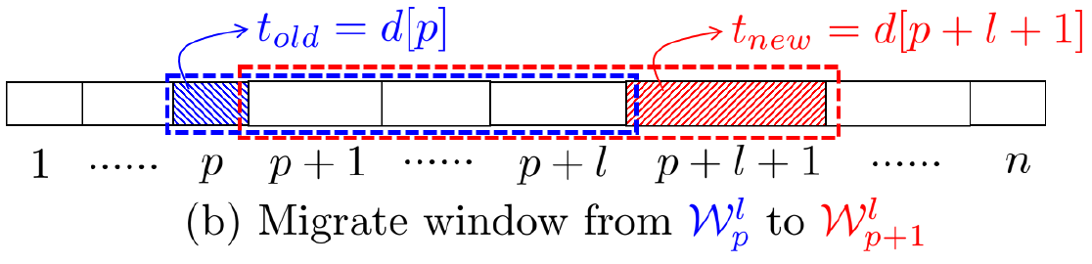
Dynamic Prefix Computation
Window Migrate
1
10
4
8
10
3
6
18
2
20
3
6
1
2
3
4
5
6
7
8
9
10

Slide 20
Outline
Motivation
Preliminaries
Framework and Techniques
Experiments
Conclusion

Slide 21
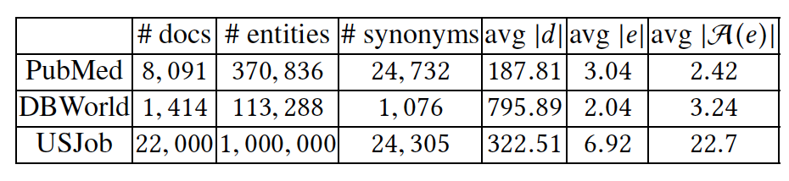
Experiment Setup
Real world datasets
Environment
C++, GCC 4.8.4.
16GB RAM, Ubuntu 14.04
Evaluation metrics
Effectiveness: Precision, Recall, F1 score
Efficiency: Query Time

Slide 22
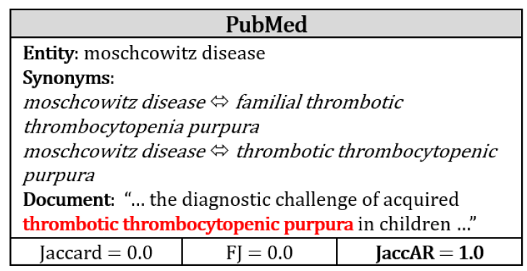
Effectiveness
Baseline methods
Jaccard
Fuzzy Jaccard(FJ) [Wang et al. 2011]: considering edit similarity
Sample Ground Truth

Slide 23
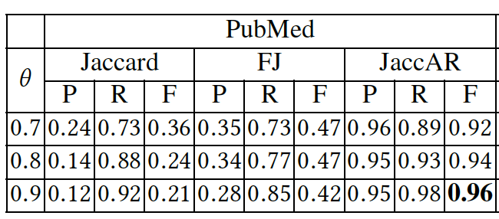
Effectiveness
Results
Our method has the best performance since it can capture the semantics contained in synonym rules

Slide 24
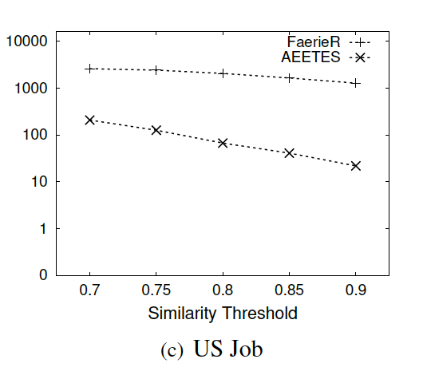
Efficiency: end-to-end result
Extending state-of-the-art methods
FaerieR [Deng et al. 2015]
Our method outperforms the best existing method by one to two orders of magnitude

Slide 25
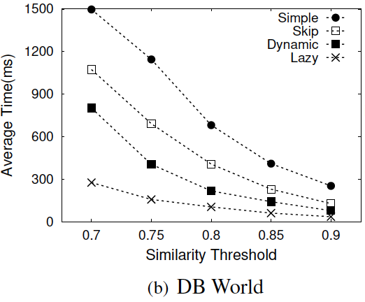
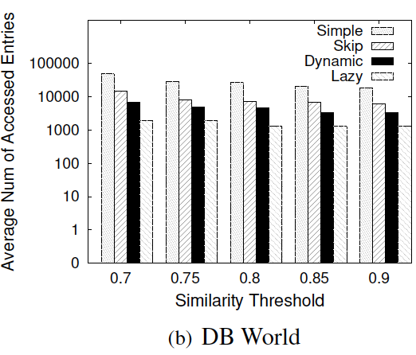
Efficiency: filtering methods
Average Query Time
Number of Accessed Items

Slide 26
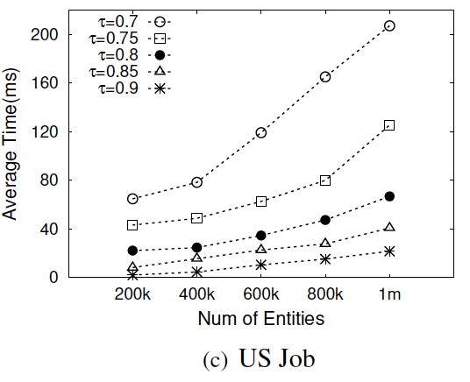
Efficiency: scalability
for τ=0.75, our method took
43.26 ms for 200k entities
62.71 ms for 600k entities
125.52 ms for 1m entities

Slide 27
Outline
Motivation
Preliminaries
Framework and Techniques
Experiments
Conclusion

Slide 28
Conclusion
A new problem: AEES
A filter-and-verification framework
Clustered indexing structures
Effective pruning techniques
Experimental results show that our methods significantly outperform existing methods

Slide 29
Thank you!
Q & A

